Slide 1
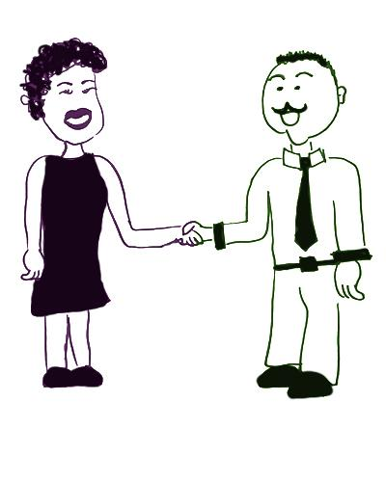
Compelling Introduction
A compelling introduction
Hi, I’m Jose. I’m a product director for Widget Co, the world’s largest widget builder. Did you know workers in the US use some kind of widget at least 5 times a day! Amazing, I know. We think the best way to make a great widget is to talk directly to customers about what they want, build at the highest quality, and provide excellent service.
Hi! I’m Marcia. My company makes gadgets.
Jose’s introduction
starts with a sentence that captures Marcia’s interest.
provides background information about widgets.
closes with three things to discuss further.

